Slide 1
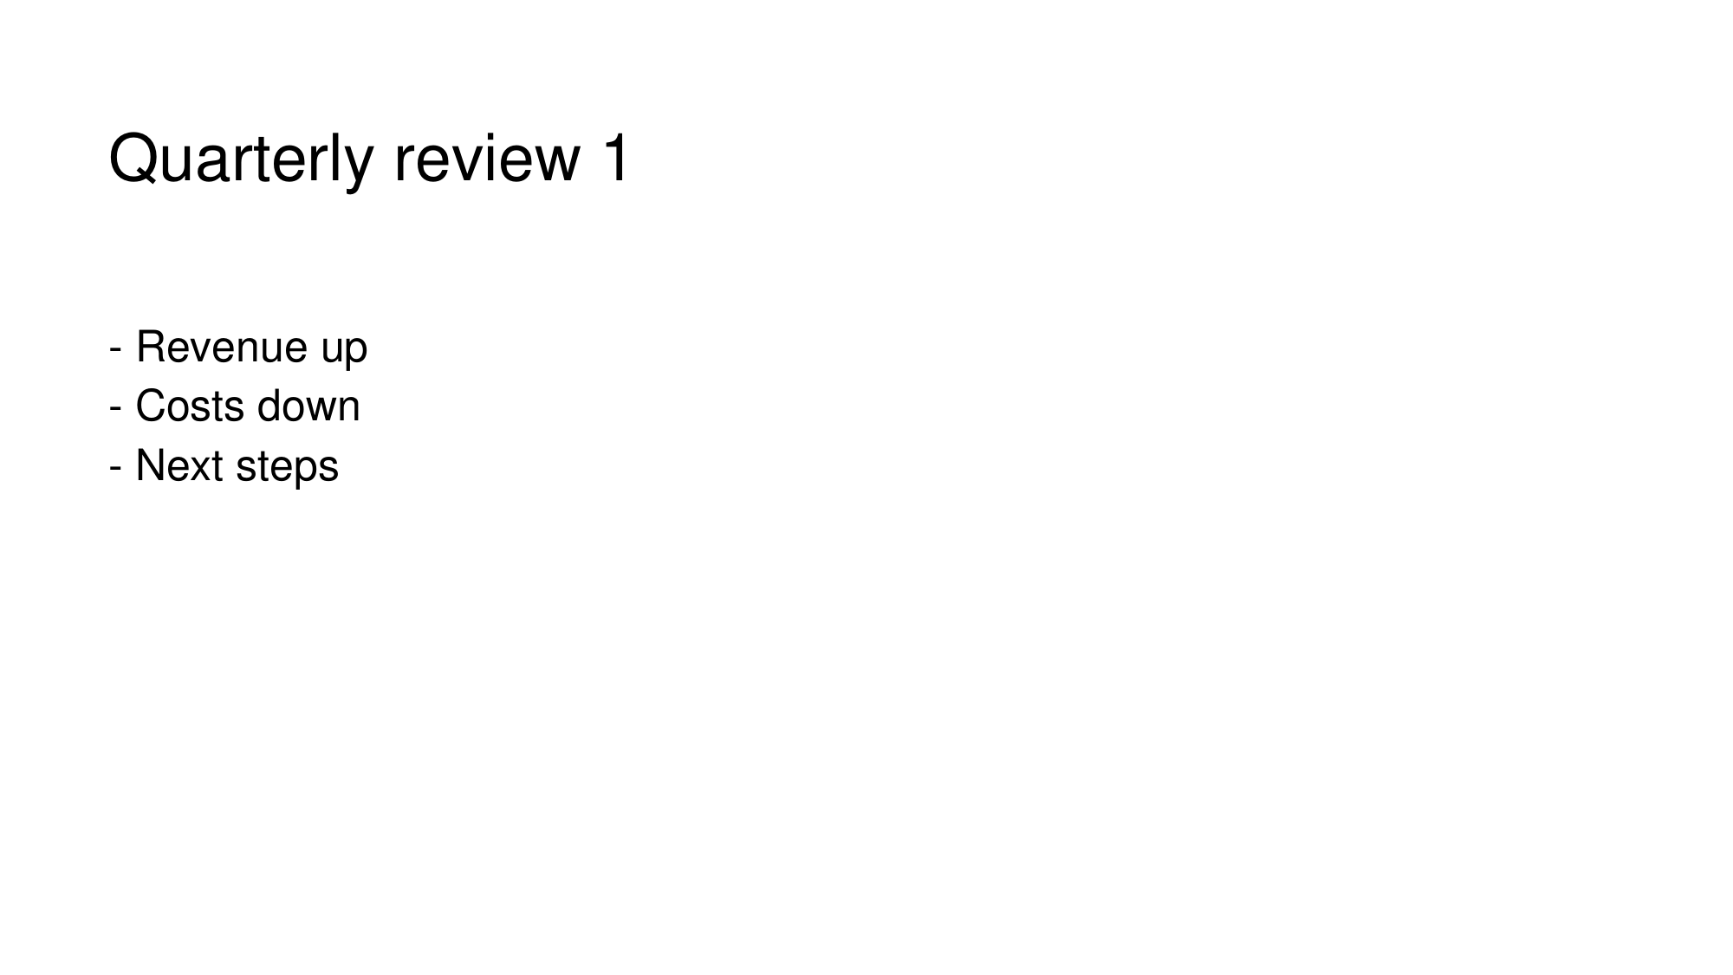
Notes:
Quarterly review 1
- Revenue up
- Costs down
- Next steps

